Slide 1

HotelStream lining Hospitality: Automating Hotel Management System for Enhanced Customer Experience
Submitted By: Submitted To:
Aditya Chandrayan(12103164) Dr. Ranjith Kumar A
Arjun Sharma(12103353)

Slide 2

INTRODUCTION
The Hotel Booking Management System is a software project developed in Java that provides a user-friendly interface for hotel administrators and guests to manage hotel reservations efficiently. The system allows guests to make reservations, check room availability, and view details about the hotel. It also enables administrators to manage reservations, room availability, pricing, and customer information. The primary goal of the project is to provide a centralized platform that streamlines the booking process and improves the overall efficiency of hotel management. With this system, guests can book their stay easily, and administrators can manage hotel operations efficiently. The Hotel Booking Management System is an excellent tool for the hospitality industry, helping hotels deliver a better experience to their customers.

Slide 3

Objective
The objective of the hotel booking management project in Java is to create a software system that enables efficient management of hotel reservations and bookings. The system should allow customers to search for available rooms, make reservations, and manage their bookings. It should also enable hotel staff to view and manage reservations, update room availability, and generate reports. The project should be designed to be user-friendly, secure, and scalable, allowing for easy expansion and customization. Additionally, the system should be capable of integrating with other hotel systems, such as payment gateways, to streamline the booking process and improve customer satisfaction.

Slide 4
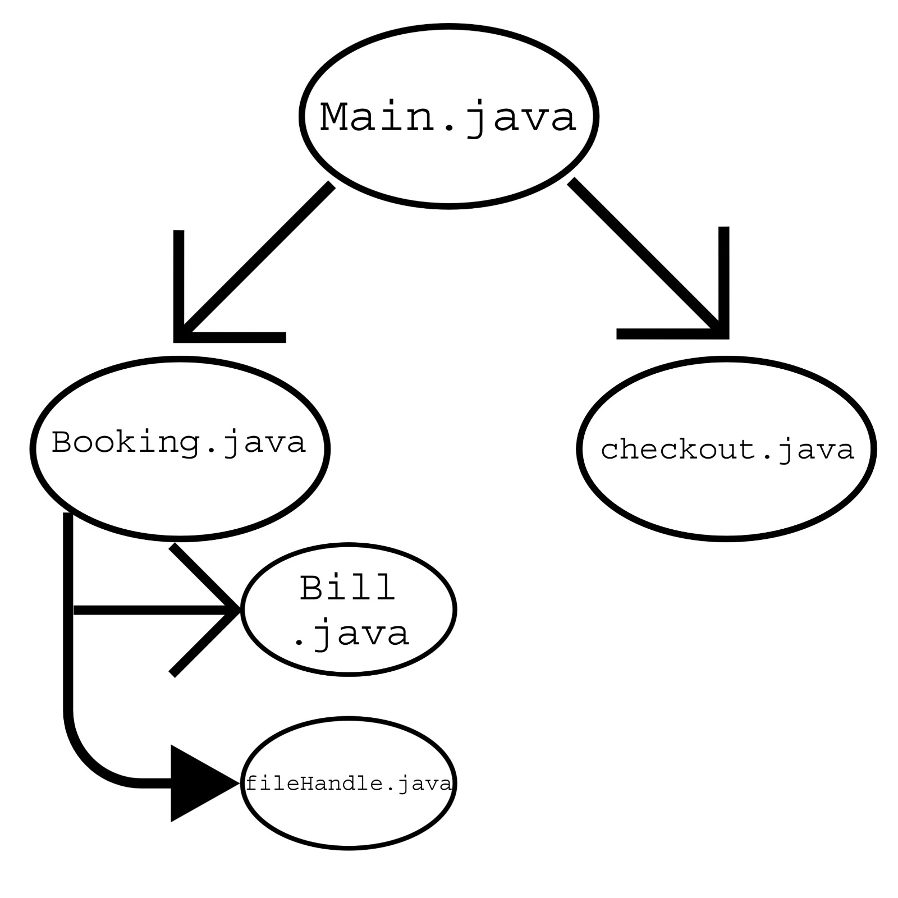
Modules

Slide 5
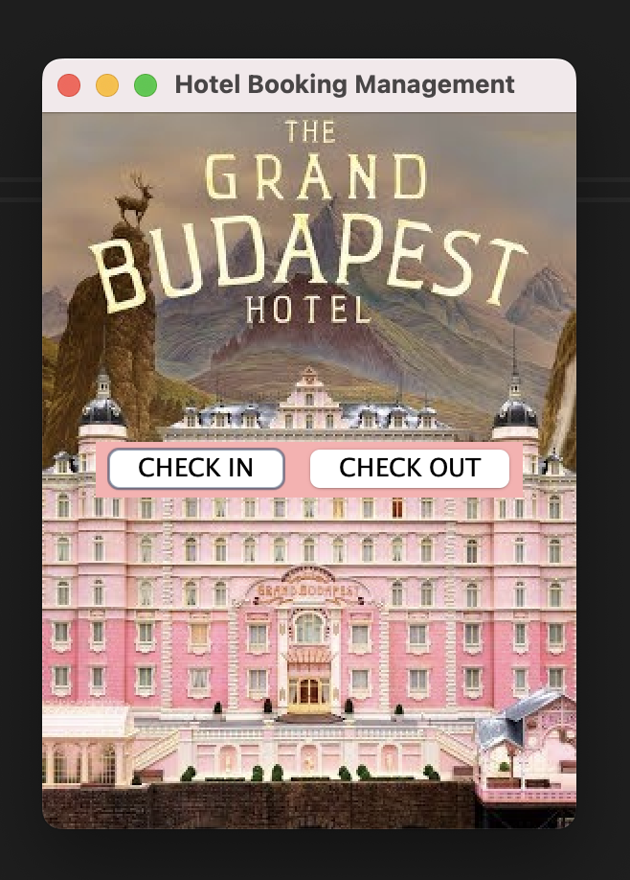
Homepage
The user is greeted with home screen first.
The User has two choices:
Check In to The Hotel System
Check Out Of the Hotel System

Slide 6
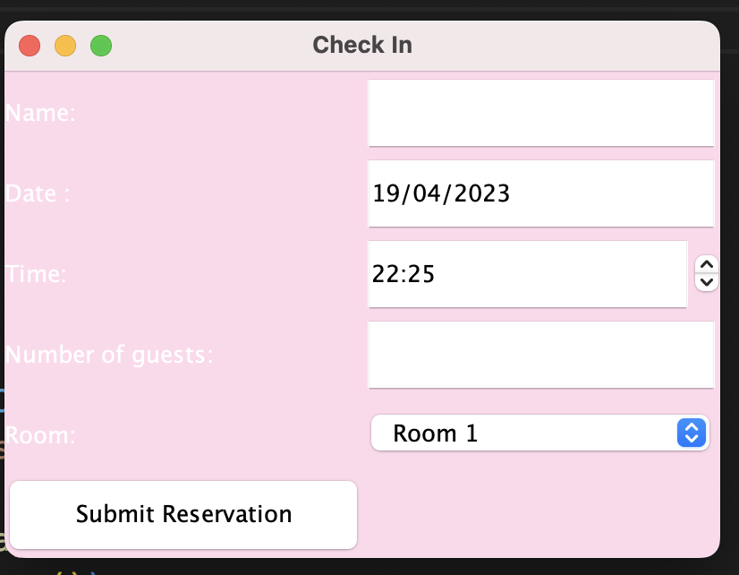
Check In
Upon opting for the Check In Module
The User is asked to put his/her details in the form:
If the room is already reserved the user will be asked to retry again.
Else, the user is successful in reserving the room and registered in the hotel system.

Slide 7
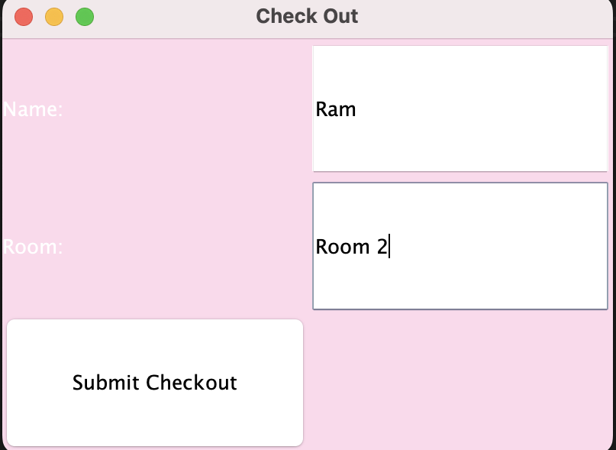
Check Out
Upon opting for the Check Out Module:
The User is asked to put his/her details in the form:
If the given room is reserved under the given name then the user can successfully
Else, the system throws an error and the operation is unsuccessfull.

Slide 8

Future of Hotel Booking Management
The Hotel Booking Management System has vast potential for future development and expansion. The system can be enhanced with additional features, such as integrating with online payment gateways, adding multiple language support, and providing recommendations for local tourist attractions. The system can also be made more flexible and customizable to cater to the specific needs of different types of hotels. Moreover, with the rise of artificial intelligence and machine learning, the system can be improved to offer personalized recommendations and insights to guests. The project can also be extended to a mobile application, allowing guests to book rooms on-the-go, and to offer loyalty programs for frequent guests. In conclusion, the future scope of the Hotel Booking Management System is vast, and with continuous development and innovation, it can become a game-changer for the hospitality industry.

Slide 9

Future Scope
Database can be integrated into this application for secure handling of the data.
The UI/UX experience can be enhanced for more user interaction.
More services could be included to make the user feel more comfortable.
Demonstrate functionality that allows users to:
Login
How customers make bookings for a specific room
﻿Make a booking for a specific room
﻿Register users that don't currently have an account
﻿Search functionality

Slide 10
Conclusion
In conclusion, the development of a hotel booking management system is a complex task that requires a range of technical skills and expertise. However, a well-designed system can offer many benefits to hotel businesses, including improved booking efficiency, better inventory management, and increased revenue.
Through the development process, it is important to consider the specific needs of the hotel business and its customers. Key features such as online booking, real-time availability, and automated notifications can enhance the user experience and increase customer satisfaction . It is also important to consider potential challenges such as data security, scalability, and system integration when designing and implementing the system . Overall, a hotel booking management system in Java can be a valuable tool for streamlining hotel operations, improving customer service, and driving business growth.

Slide 11


